Slide 1
Audio Map Guide
OKONKWO IFEANYICHUKWU FE17A068

Slide 2
What has been done? - Problem & Approach
The aim of Audio Map Guide app is to provide students in university of Buea means to navigate through the Campus
The app gives a path to a building, as requested by the user
Using client-server model to implement the concept , since the workload given to the smartphone needs to be reduced to optimize memory and battery consumption.

Slide 3
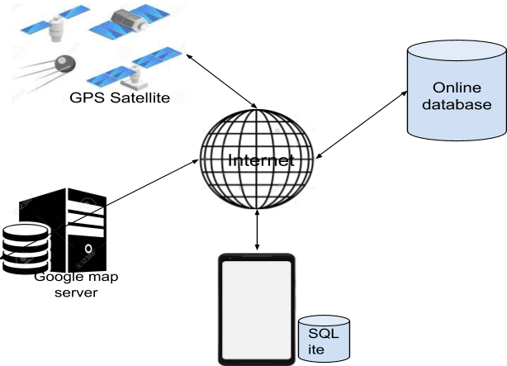
System Description - Diagram

Slide 4
Problem and Propose Solution

Slide 5
This work addressed the issue of designing and implementing a mobile campus map guide application that aids navigation and location of landmarks within the campus

Slide 6
The system was designed with the view of providing maximum
simplicity, quality user experience, great user interface and most importantly accurate
data.

Slide 7
The application allows a user to select source and destination locations and displays the shortest path.
The user can select whether this is a walkable or drivable path. This feature is especially useful on campus since people often walk between buildings.
The application provides navigation capabilities based on the user type. A user enters the destination location and based on the current location.

Slide 8
The input can be done by typing in the text or by voice note.
The application provides rerouting if the user departs from the projected path.

Slide 9
Agile software approach​ was employed for the application development due to the fact that is it is an iterative incremental development where requirements for a system can evolve during the lifetime of the software.

Slide 10
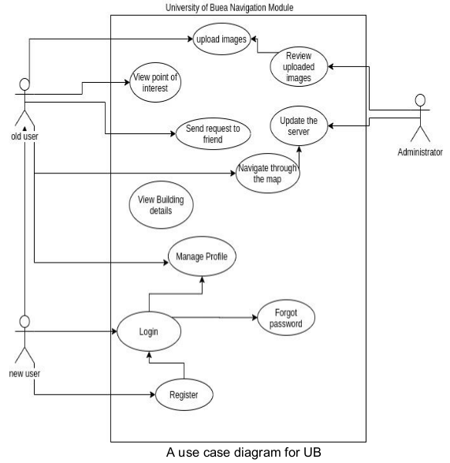
Use Case Model

Slide 11
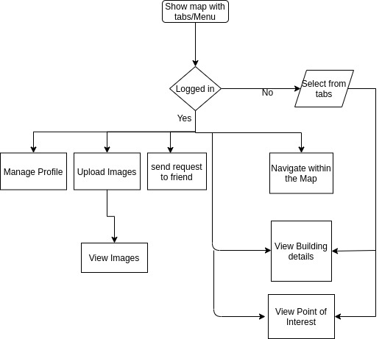
System design Flow chart

Slide 12
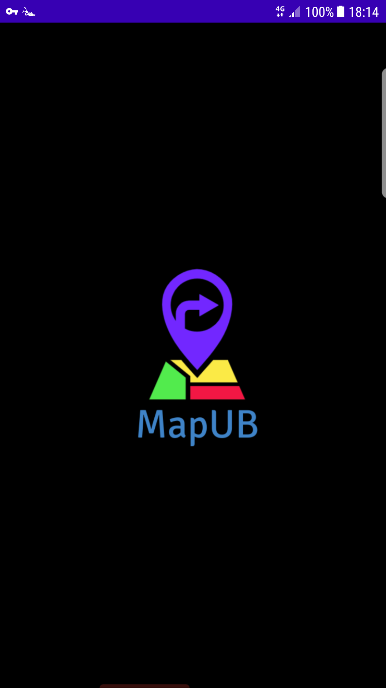
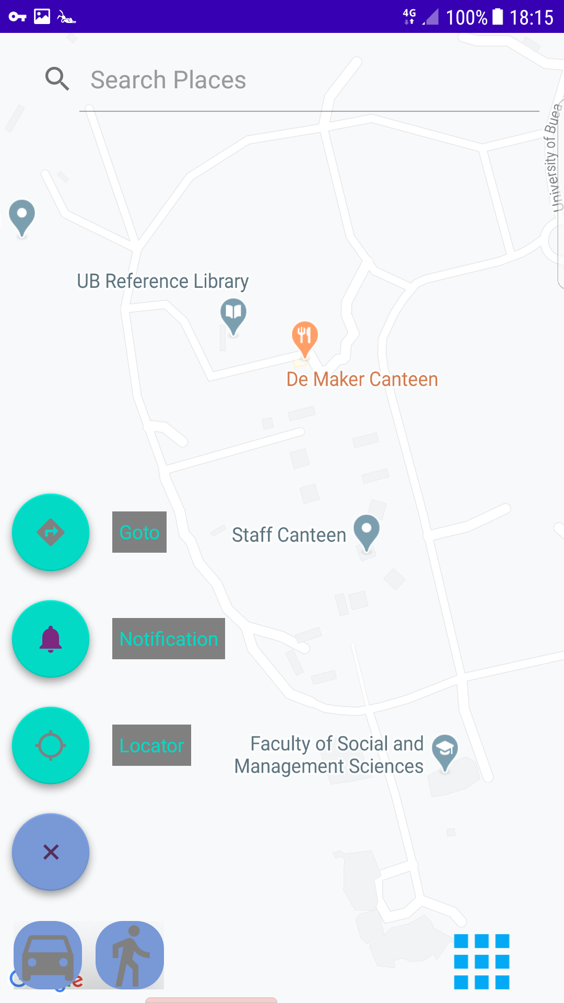

Slide 13
Functional Requirement
Users should be able to register and log in to the system.
User should be able to update his/her personal information.
Users should be able to view the map of the UB campus.
Users should be able to view his/her current location.

Slide 14
Non-functional Requirement
1. User data changes should be synchronised with the server in real-time.
2. All buildings’ data should be stored in the database and not hardcoded in the
application source code.
3. All uploaded images should be stored on the server and retrieved on demand.

Slide 15
Future work
The backend of the application and include the required functionality as specified on this document.
More knowledge about cloud computing is the need for the hosting of the application server over the internet
Improvement in the design of the application for user friendly.

Slide 16
Integrating the Front end with the backend.
The purchase of API KEY geolocation, searching, geo-positioning on the map is required
Researching on building up a special map route that can not be based on Google API

Slide 17
Project timeline
April 27
May 10
May 30
June 8
June 10
June 26
July 15
Brainstorm on project Idea
System Description and Task Analysis
Prototype of the system
Evaluation of Prototype
Implementation of the system
Build the frontend

Slide 18

Thank you!

